Slide 1

Introduction to R Session 1
Dr. Muhammad Muhammad
Chair of Quantitative Methods in the Social Sciences
Chair of International Relations

Slide 2



About this course
We will cover the basics of data manipulation in R
Building on previous teaching material prepared by:
Leon Siefken
Okan Sarioglu
Dr. Lion Behrens
Course Link
Course Link

Slide 3
Why this course? Why R?
R is a free and open-source
Easy to get started with R-Studio
Used in academia and the industry
Wide userbase; most likely someone ran into the same issue as you
Even ChatGPT can help with problems
Designed for statistical analyses
Simplifies every step of your analysis

Slide 4
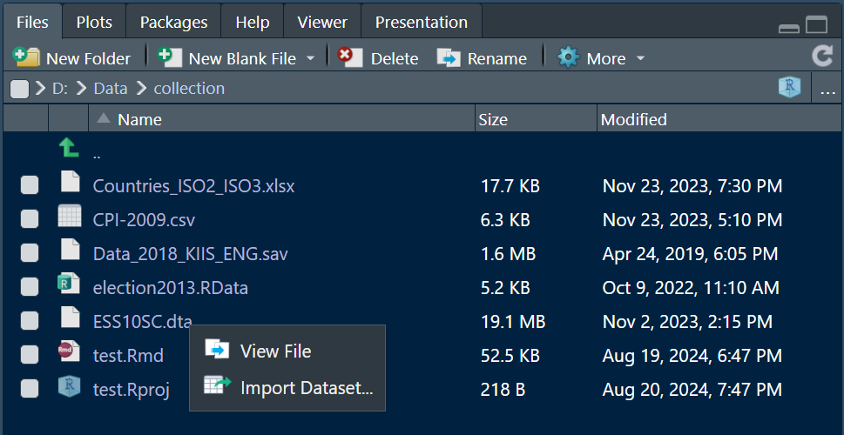
Importing and Working with Different Types of Data

Slide 5
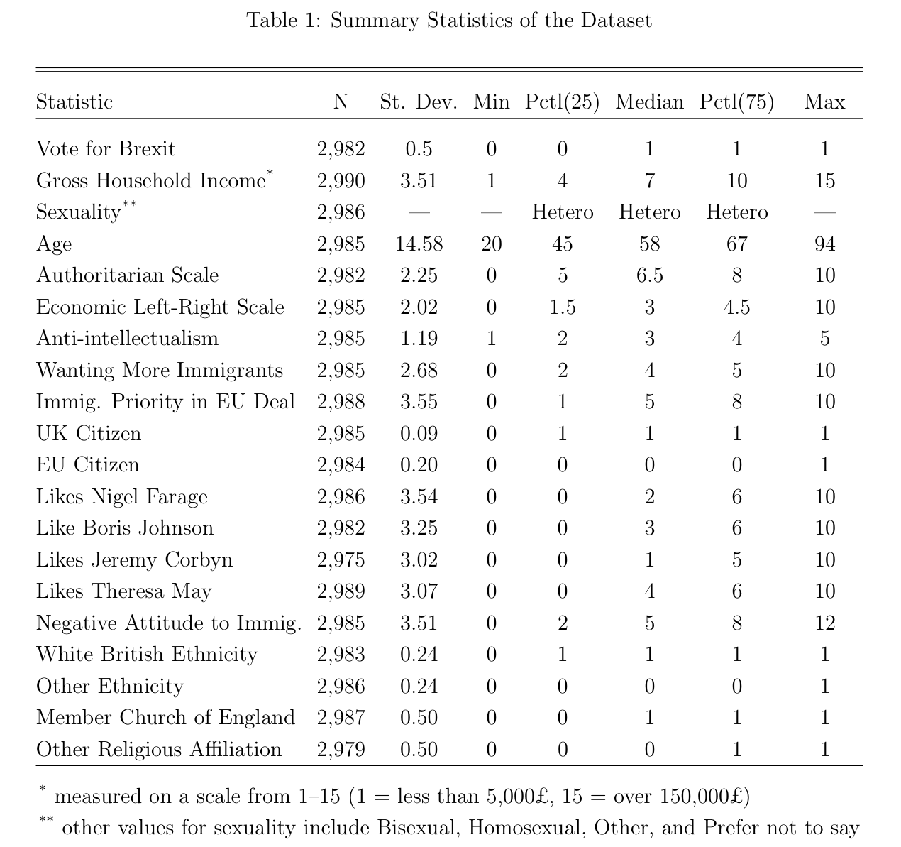
Produce formatted summary statistics tables

Slide 6
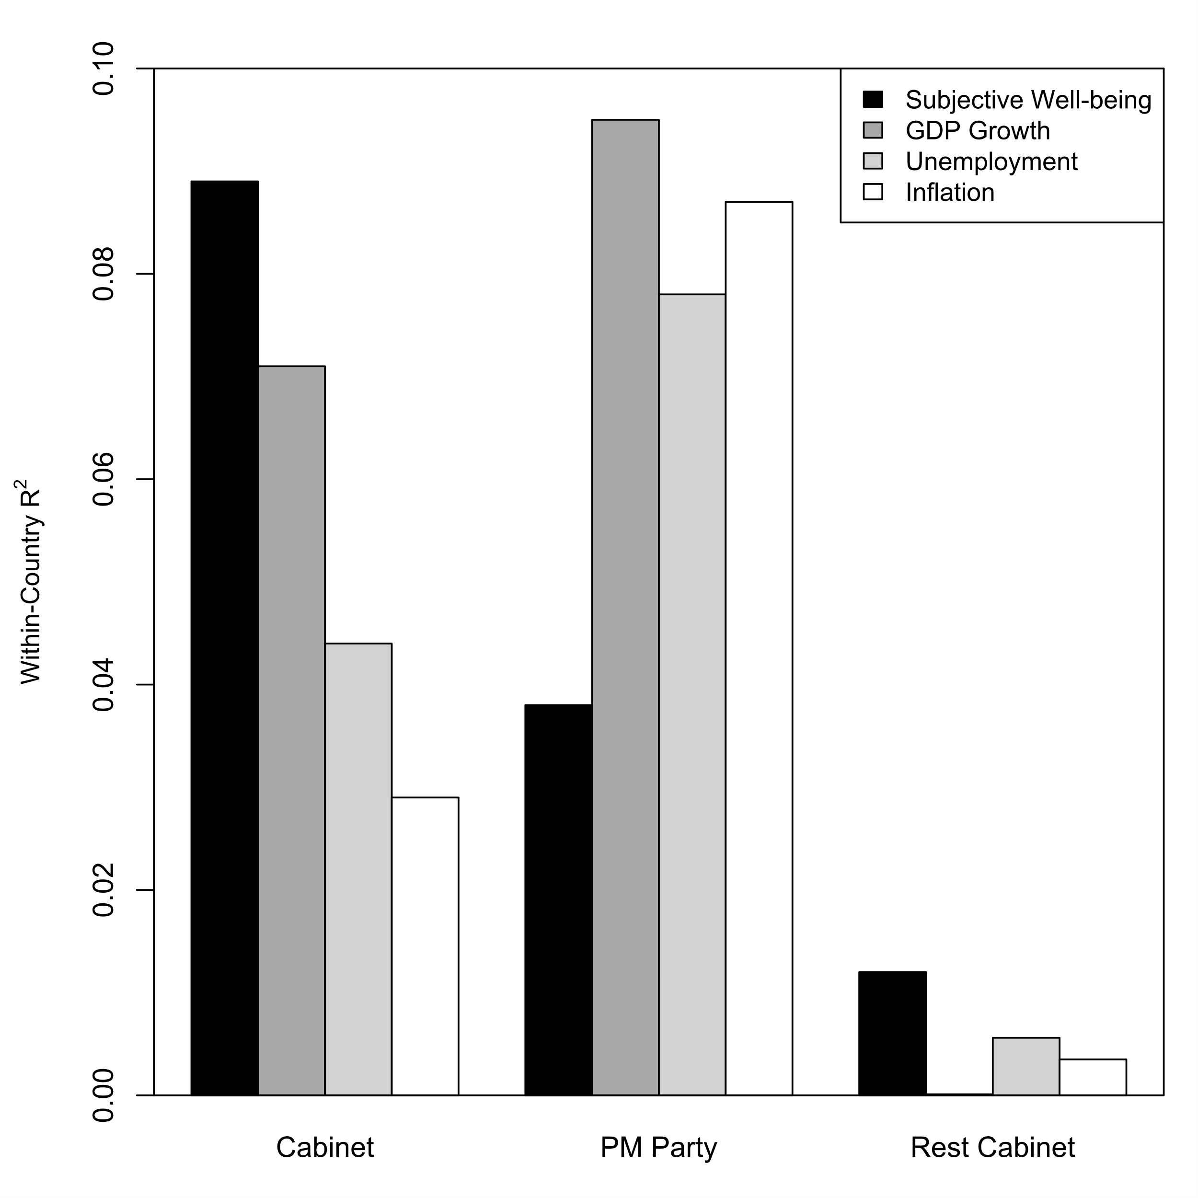
Calculate Correlations and Plot them nicely

Slide 7
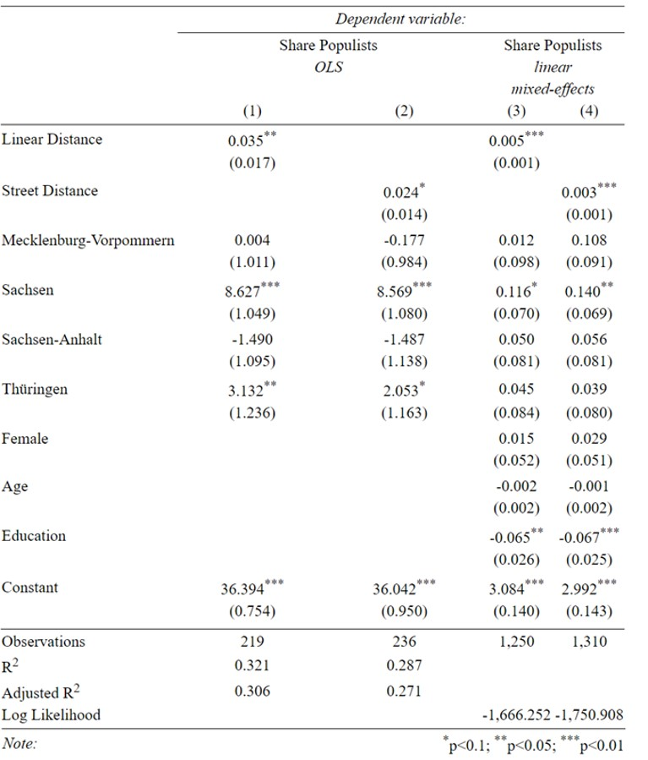
Run Regressions and Produce Regression Tables

Slide 8
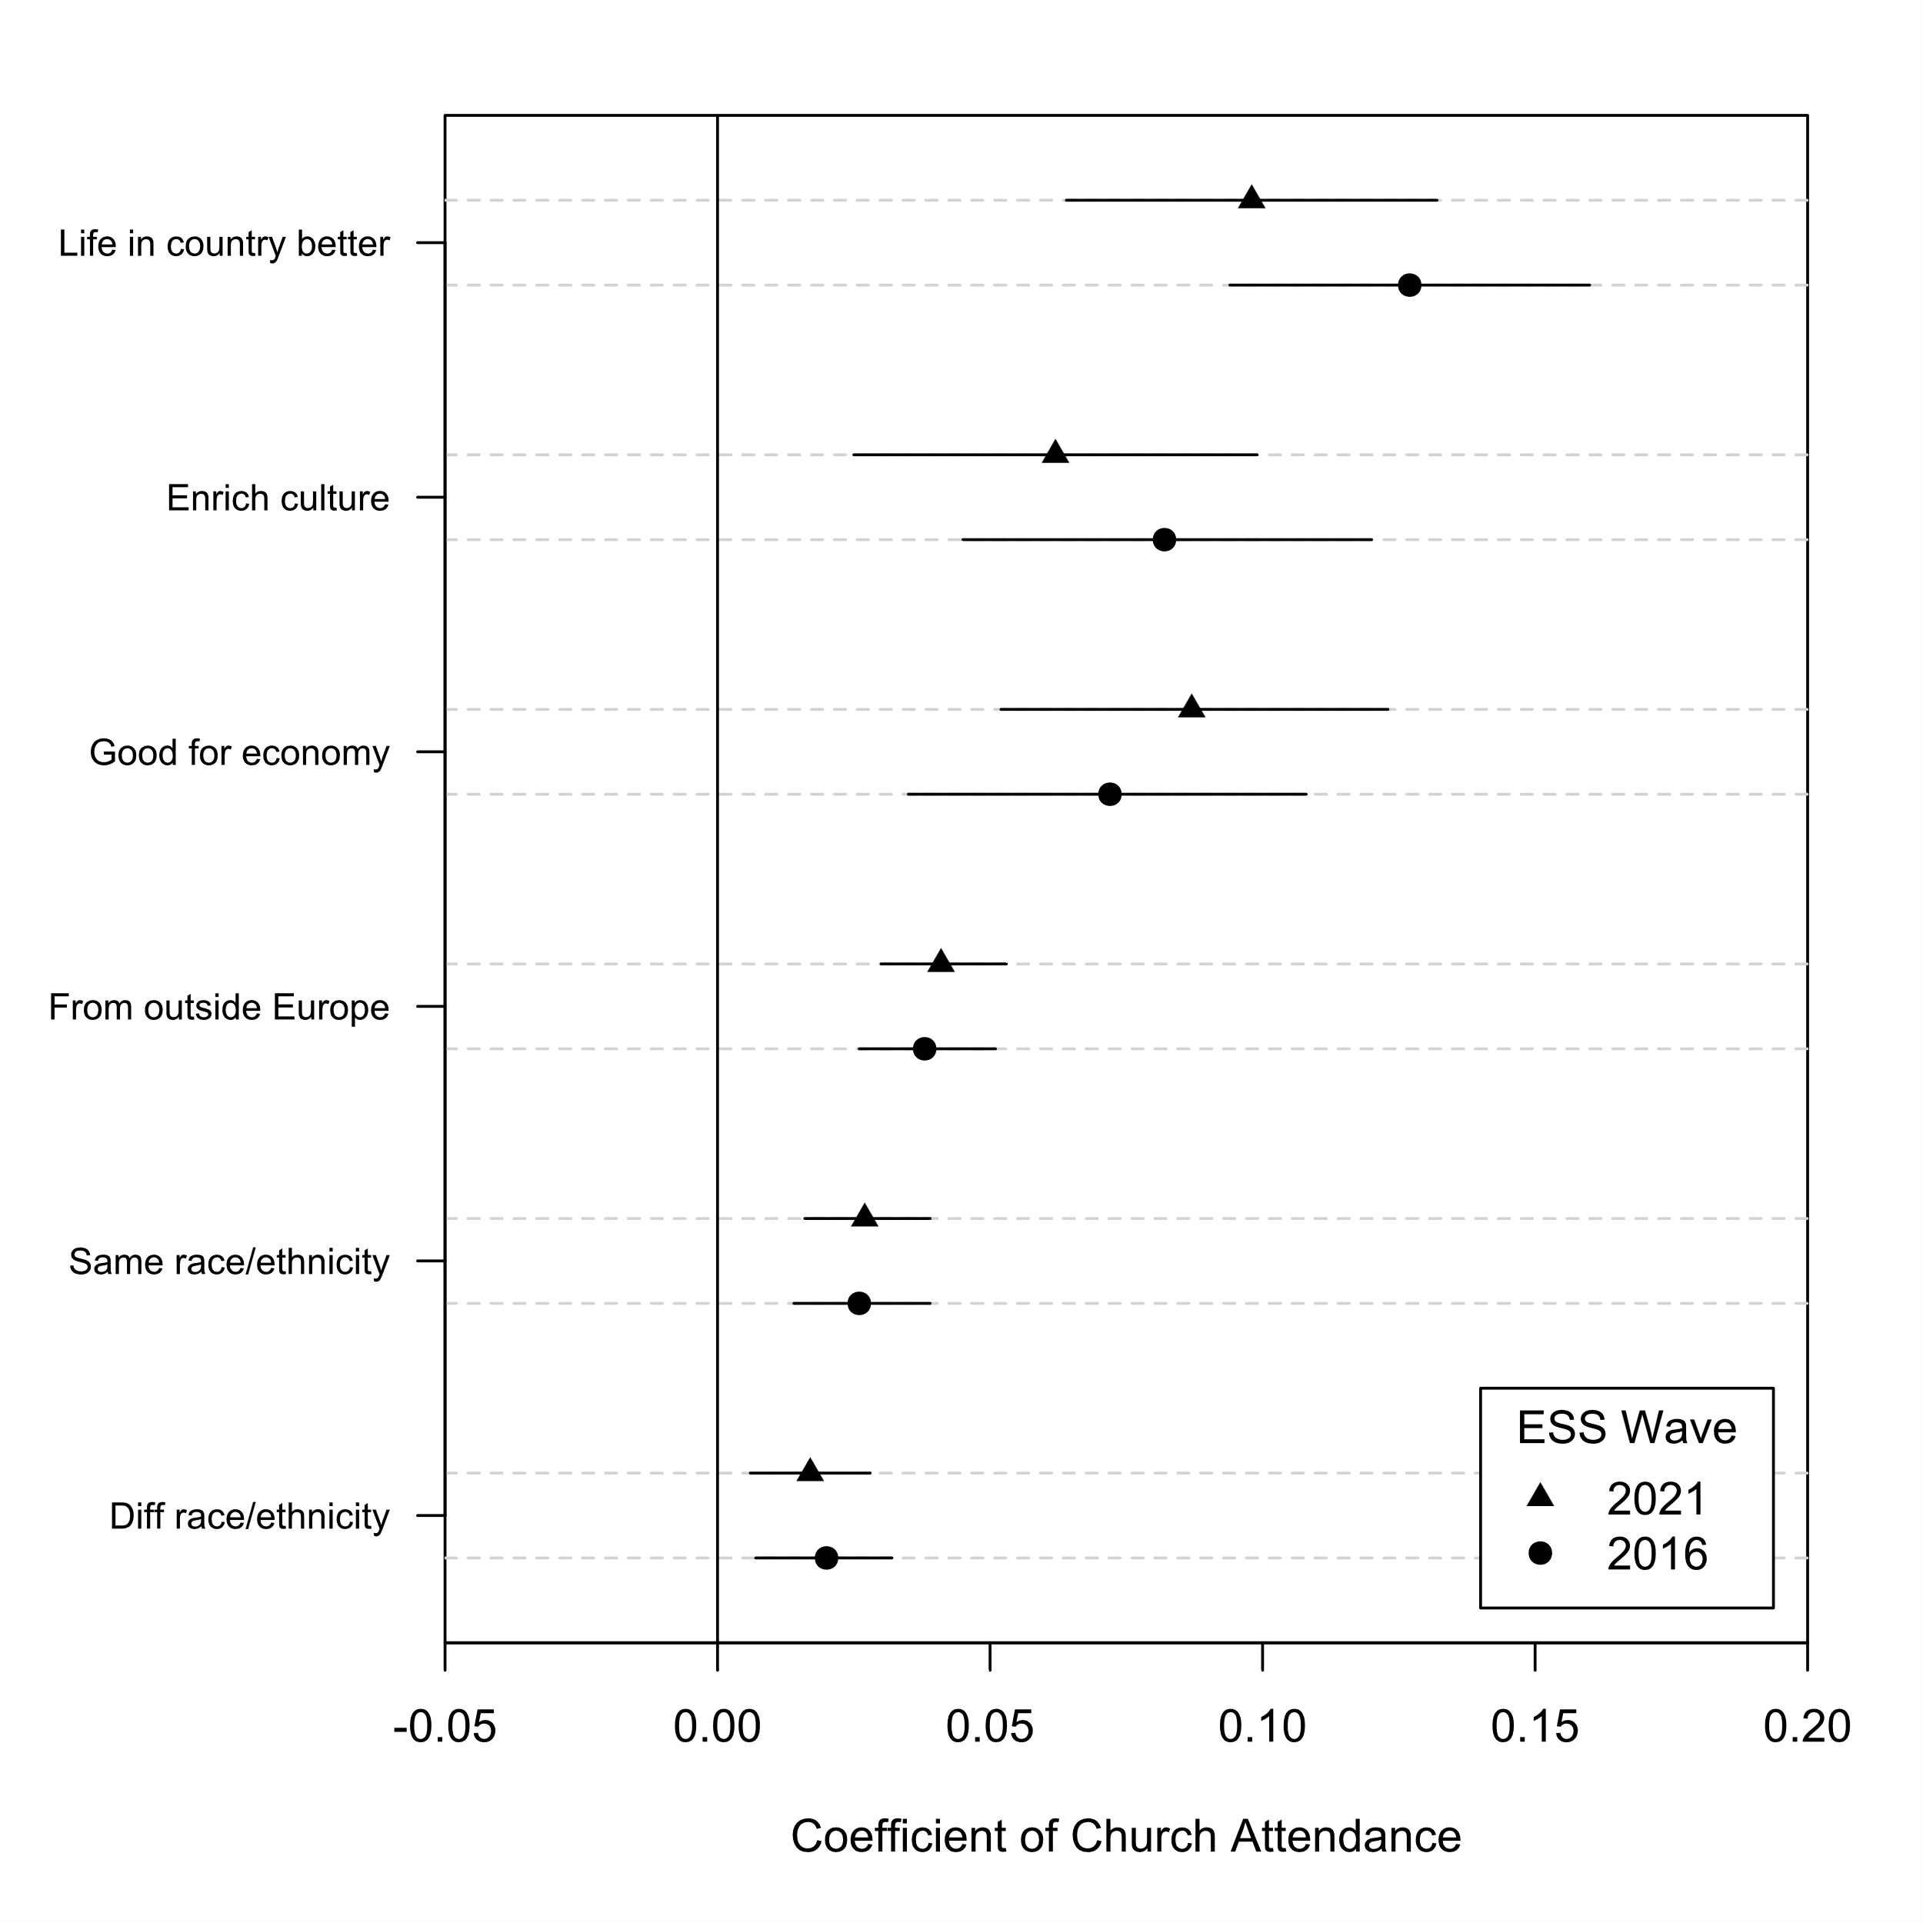
Plot regression results

Slide 9
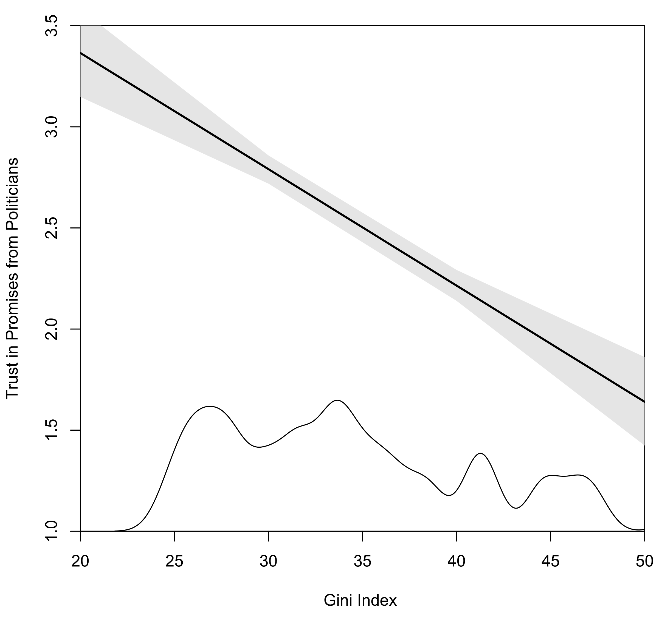
Get more substantive findings using simulations

Slide 10
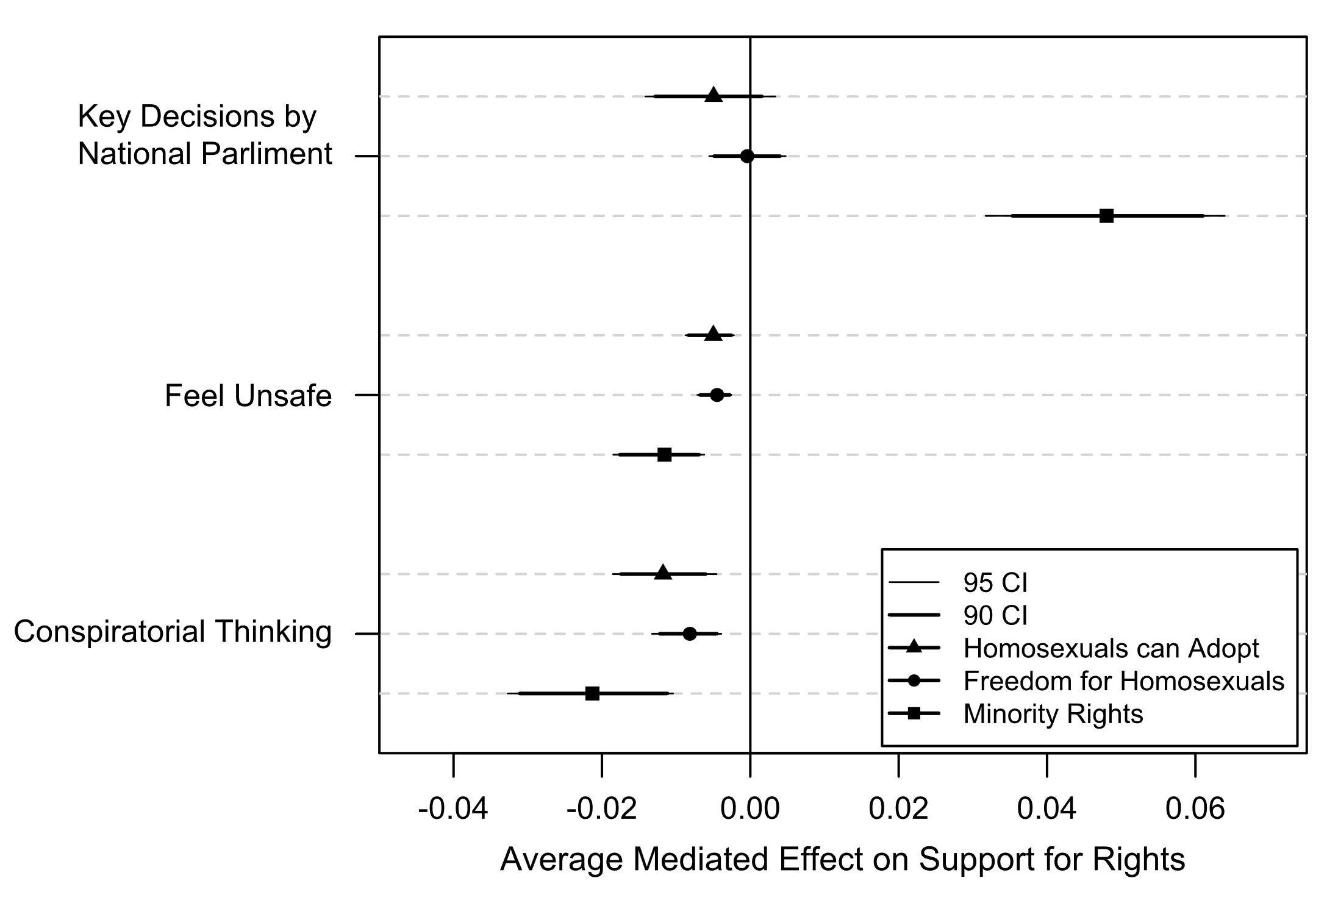
Carry out advanced analyses (e.g. Mediation Analysis)

Slide 11
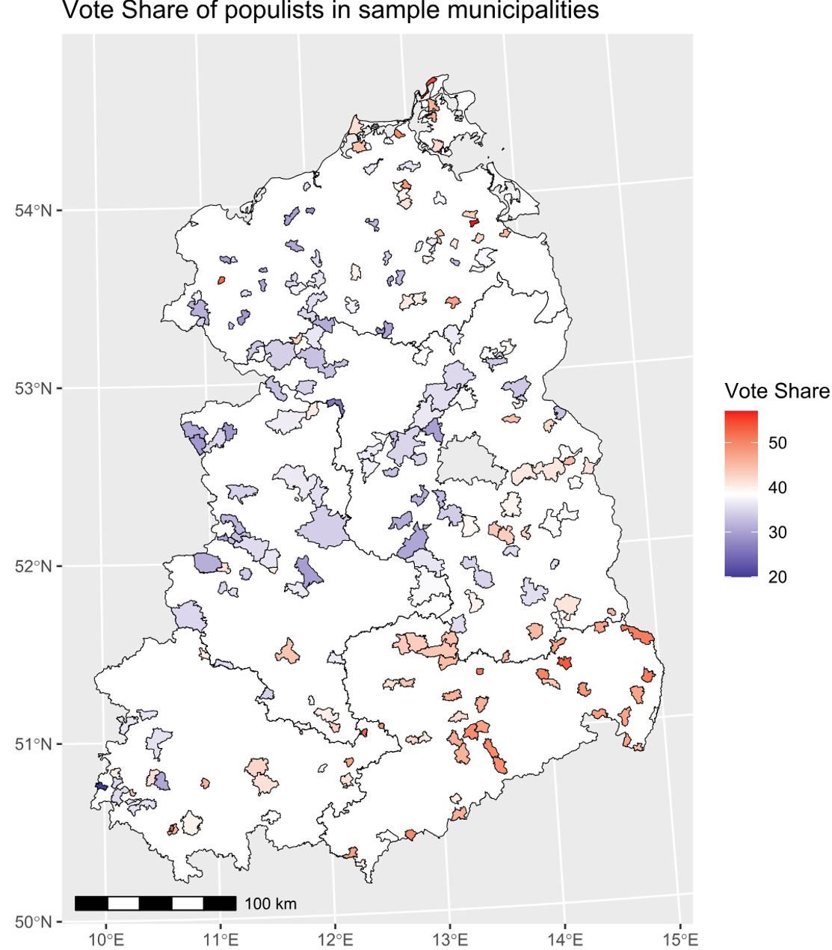
Process and Present
Spatial Data

Slide 12
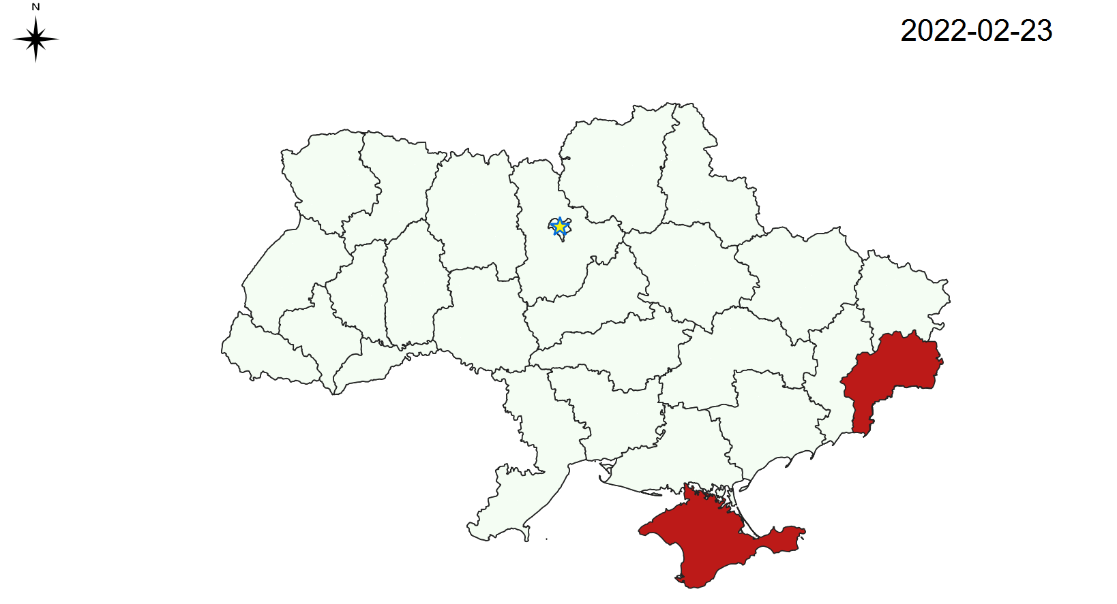
Collect data (e.g. Web-scraping)

Slide 13
Most Importantly, frees you up to take care of the rest of your paper!
Research Question
Theory & Lit. Review
Data & Methods
Results & Discussion
Conclusions & Limitations
The world is bigger than just this!

Slide 14
Course Contents
Let’s have a look at the Syllabus
In a nutshell :
Sessions 1 and 4: Most important intuitions
Session 2: Most practical use for people with coding experience
Sessions 3 (and maybe 5): Things you can pick up on your own

Slide 15
Then let’s get started with RStudio!
R files include:
R-scripts .r, a series in R commands saved in one file
RMarkdown .Rmd, formatted text and code chucks (mini R-scripts)
Session data .RData, stores results from current session
R Project .Rproj, ties all your files together and you don’t have to worry about telling R what your current directory is

Slide 16
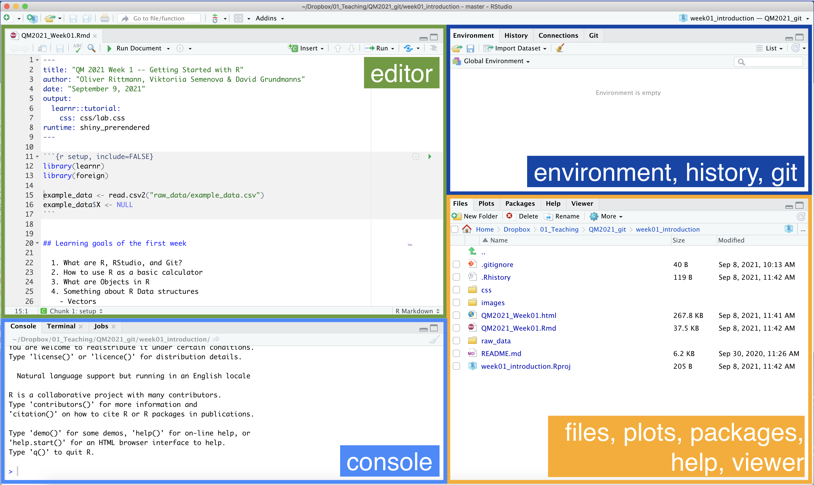
RStudio in a glance

Slide 17
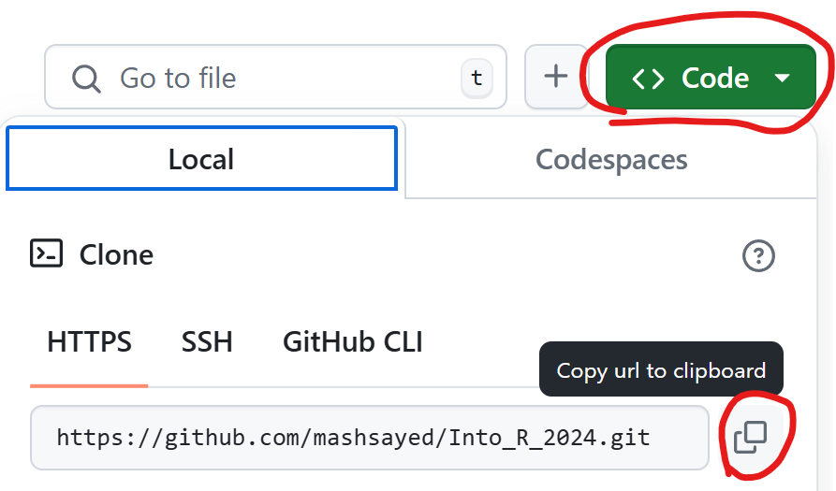
Connecting to Github
Install and get Git running: https://github.com/git-guides/install-git
Git streamlines the process of retrieving, editing, and sharing code
Go to course repository: https://github.com/mashsayed/Into_R_2024
Copy link of repository

Slide 18
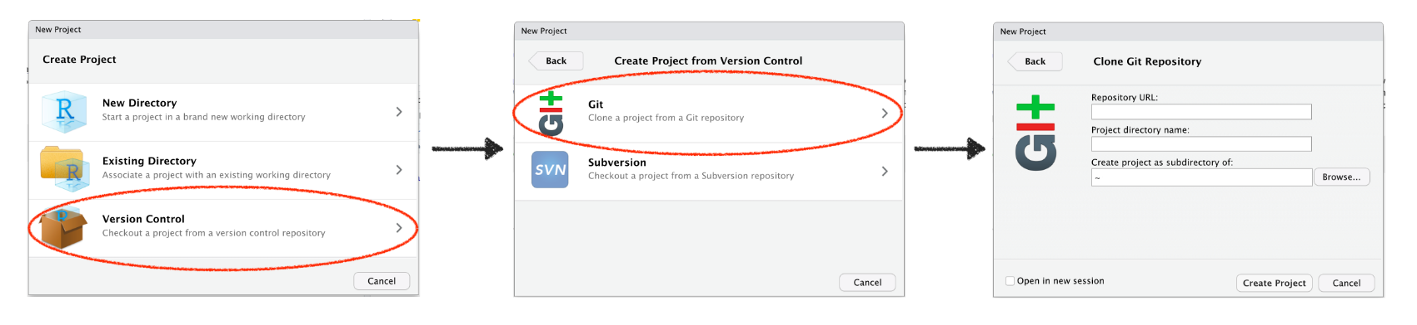
Start R project using Github
Open Rstudio >> file >> New Project…

Slide 19
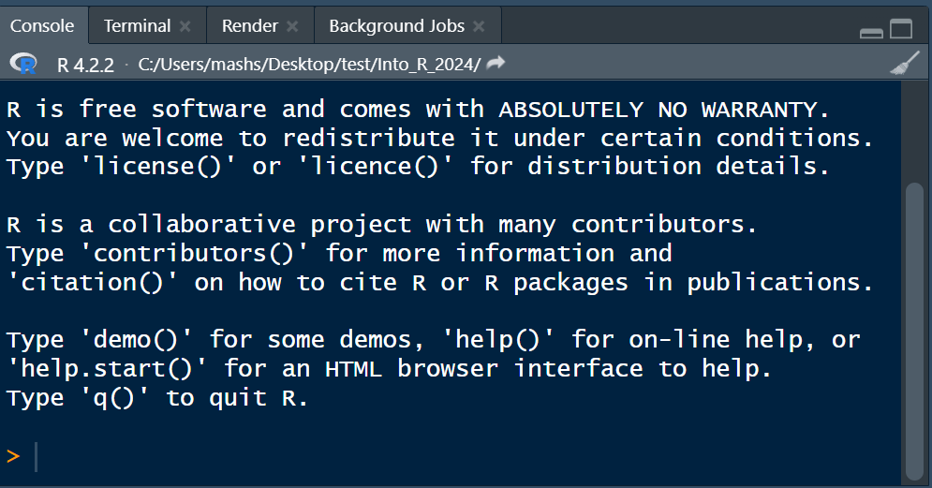
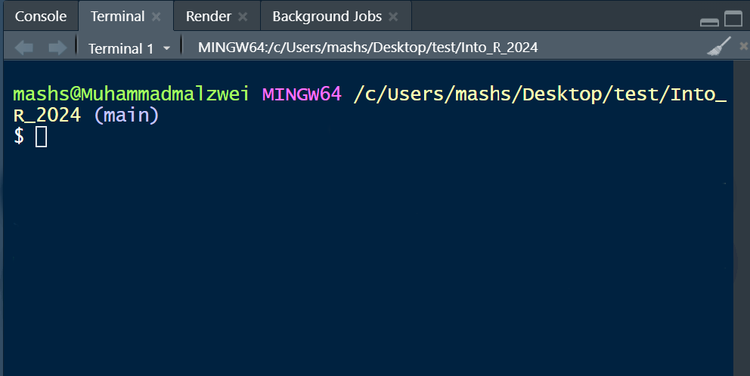
Connecting Git to your GitHub Account
In the terminal type in the following commands:
git config --global user.name “your username"
git config --global user.email “your_email@example.com"

Slide 20
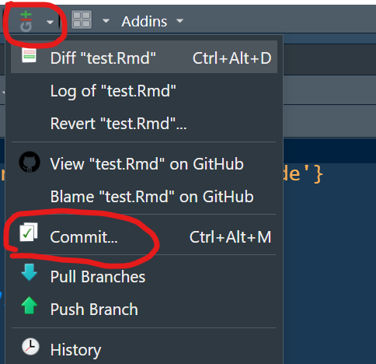
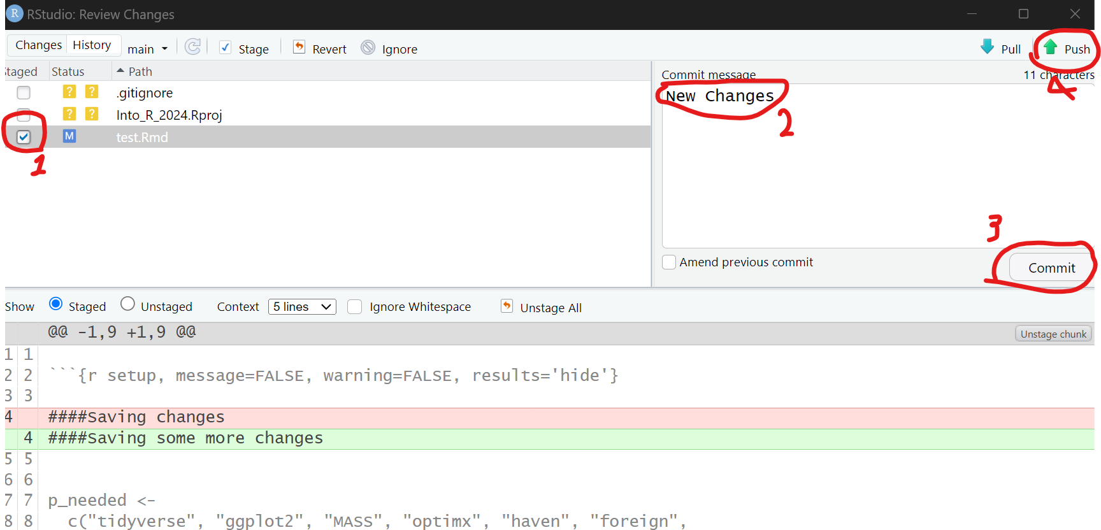
Pulling, Committing, and Pushing
Open Rstudio >> file >> New Project…
Pull: download files from the repository
Commit + Push: upload your changes

